Slide 1
“COMPARE VEHICLE INSURANCE”

Slide 2
Project Name: Compare Vehicle Insurance
Branch PG-DAC March-2023
Documentation On
“Compare Vehicle Insurance”
PG-DAC MAR 2023
Guided By: Dipali Jadhav
Submitted By :
Group No: 19
Chetan Bawane : 230343020011
Pavan Gite : 230343020034
Vaibhav Jadhav : 230343020038
Ganesh Savant : 230343020083

Slide 3
1.1 Purpose of the Project:
The purpose of the online vehicle insurance project document is to provide a detailed overview of the project, including its objectives, scope, and timeline. The document will also outline the project's methodology, risks, and deliverable.
The document is intended for a variety of stakeholders, including project managers, developers, insurance companies, and customers. It will be used to communicate the project's goals and objectives, to track progress, and to identify and mitigate risks.
1.2 Need for the Project:
The traditional process of comparing vehicle insurance policies involves contacting multiple insurance companies, manually gathering quotes, and trying to understand complex policy terms. This process is time-consuming and often leads to confusion among customers. There's a need for a centralized platform that allows users to easily compare different insurance plans, understand their features, and make informed decisions based on their preferences and needs.

Slide 4
1.3 Beneficiaries of the Project:
Customers: Customers can easily compare various insurance plans offered by different companies, allowing them to choose a plan that suits their needs and budget.
Policy Company: Companies can showcase their insurance plans to a highly targeted audience actively looking for insurance options, leading to higher-quality leads.
Administrative Staff: The project will simplify administrative tasks, leading to fewer errors in managing companies, records. This will result in increased productivity and a smoother workflow.
Car Company: Providing insurance services can enhance customer loyalty by creating a stronger bond between the car company and the car owner.
Government of India: The project could contribute to increasing financial literacy among citizens by educating them about insurance concepts and helping them understand policy terms and benefits.

Slide 5
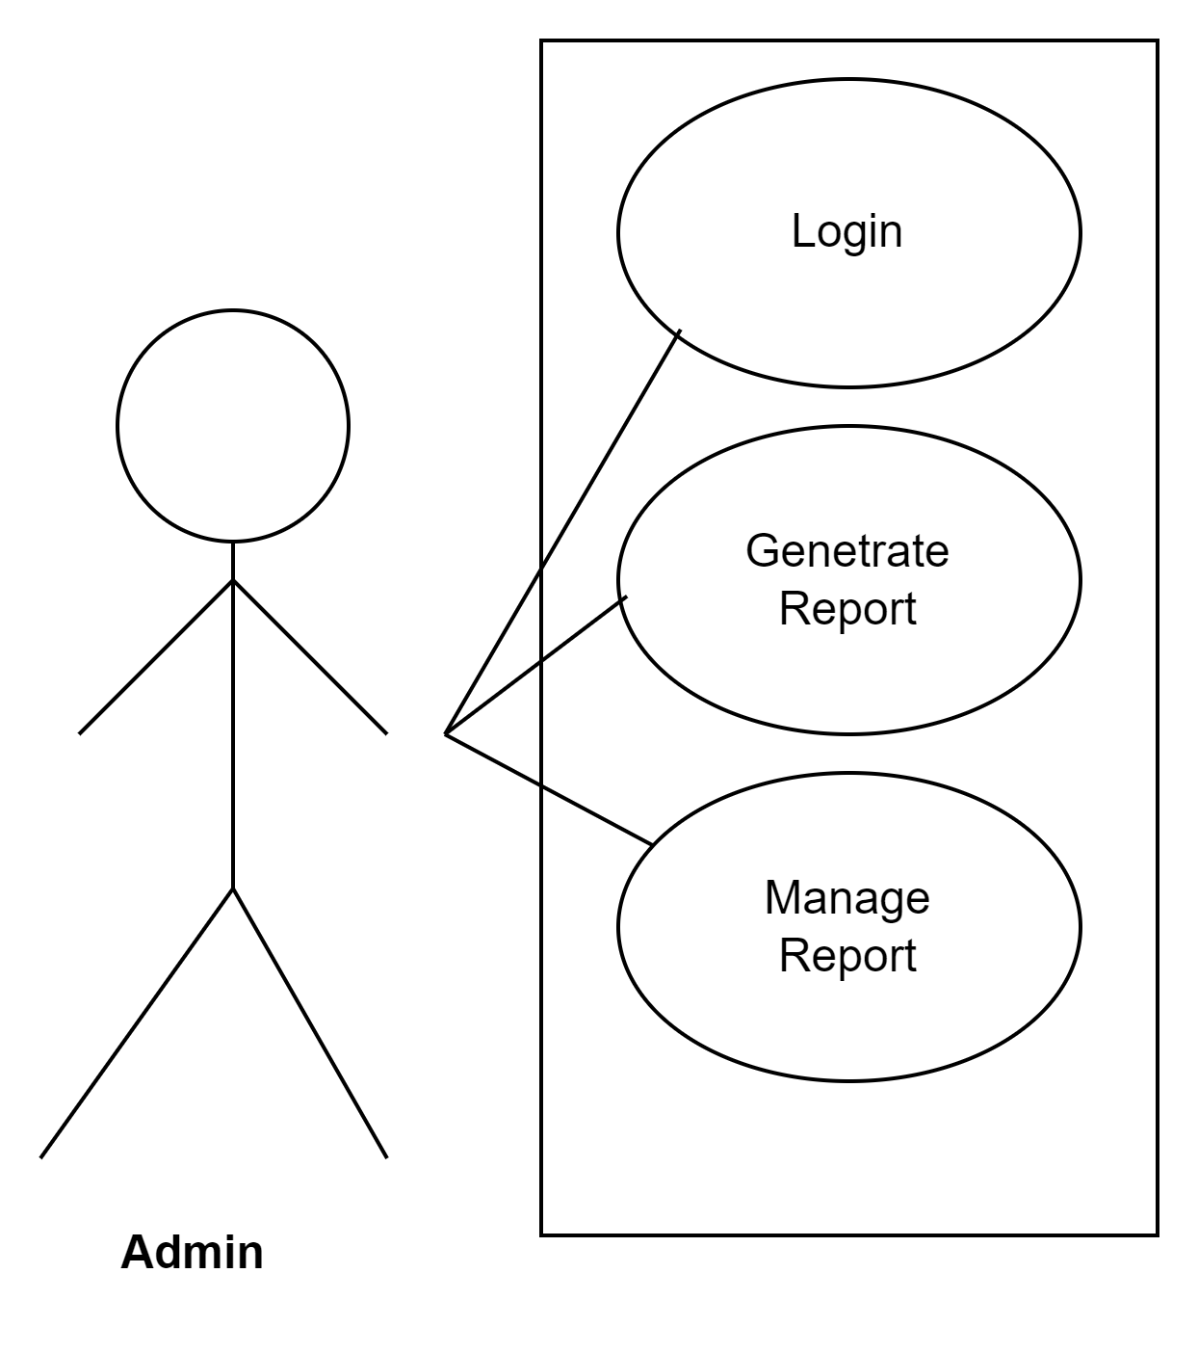
Roles and responsibilities:
Admin

Slide 6
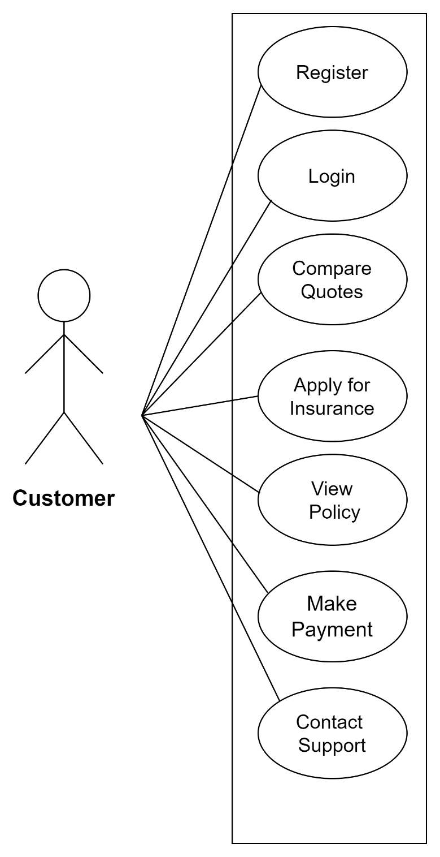
Customer

Slide 7
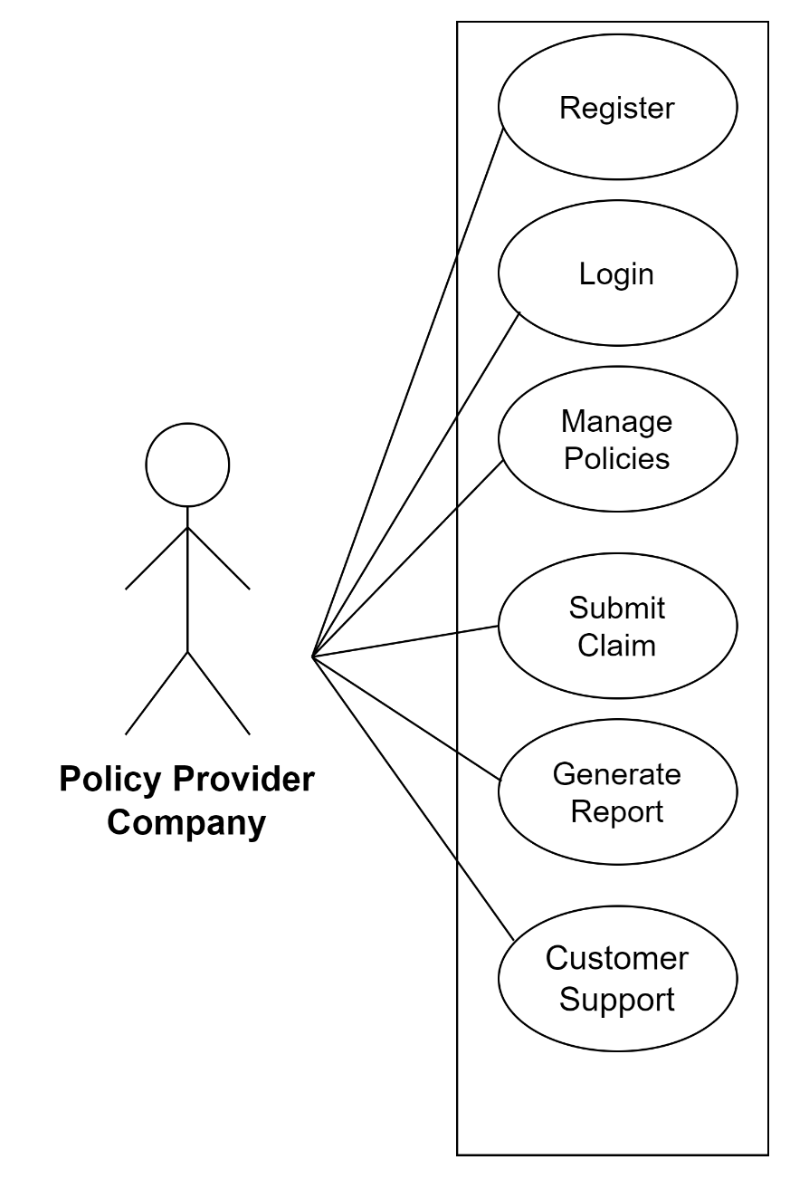
Policy Provider Company

Slide 8
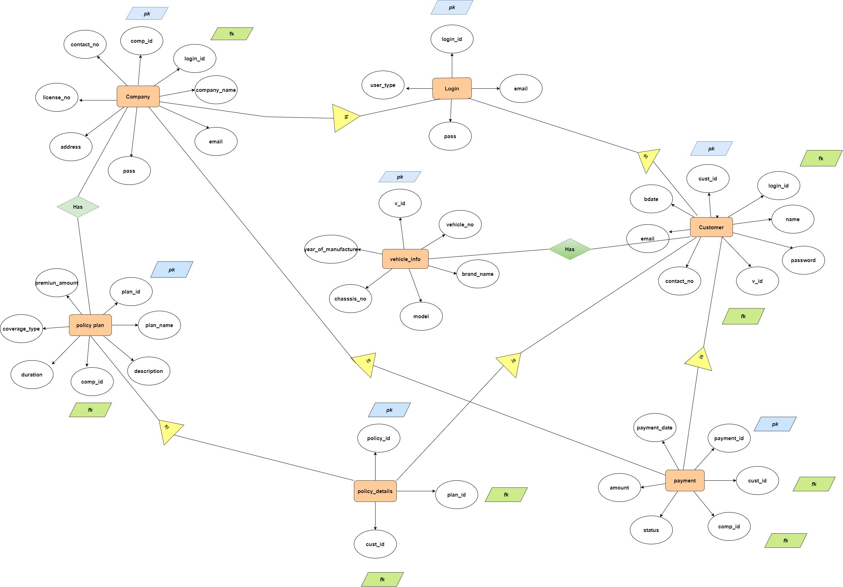
Database design:
ER-Diagram

Slide 9
Technologies platform used for these project:
Front-End: React JS
Middle-Tier: Java, Spring Boot REST API
Database: MySQL
Front-End - React JS:
User Experience: React JS offers a dynamic and responsive user interface, enhancing the overall user experience.
Component-Based: Reacts component-based architecture allows for modular development, facilitating code reusability and maintainability.
Vibrant Ecosystem: React has a large and active community, offering a wide range of libraries, tools, and resources for development.
Middle-Tier - Java and Spring Boot REST API:
Robustness and Reliability: Java is known for its robustness and reliability, making it suitable for building critical components of the system.
Spring Boot Simplification: Spring Boot provides a streamlined way to build production-ready applications with ease, reducing development time.
REST API: REST architecture ensures a scalable and flexible communication layer between the front-end and database.

Slide 10
Database - MySQL:
Relational Model: MySQL's relational database model is well-suited for structured data like policies, customers records.
Community Support: MySQL has a strong community and is widely used, providing extensive resources and troubleshooting options.
Performance: MySQL offers good performance for read-heavy operations, which is important for managing appointments.

Slide 11
Conclusion
Challenges we faced :
There were many challenges that we faced like finding a write path to start with, exploring the technologies beyond the horizon of our course Etc.
Things Learnt :
We have learnt to efficiently distribute the task within the team. We have learnt to combine all the dynamic stack of technologies together to create a fully functional software.
Overall Experience :
Overall experience was very practical oriented and highly knowledgeable.

Slide 12
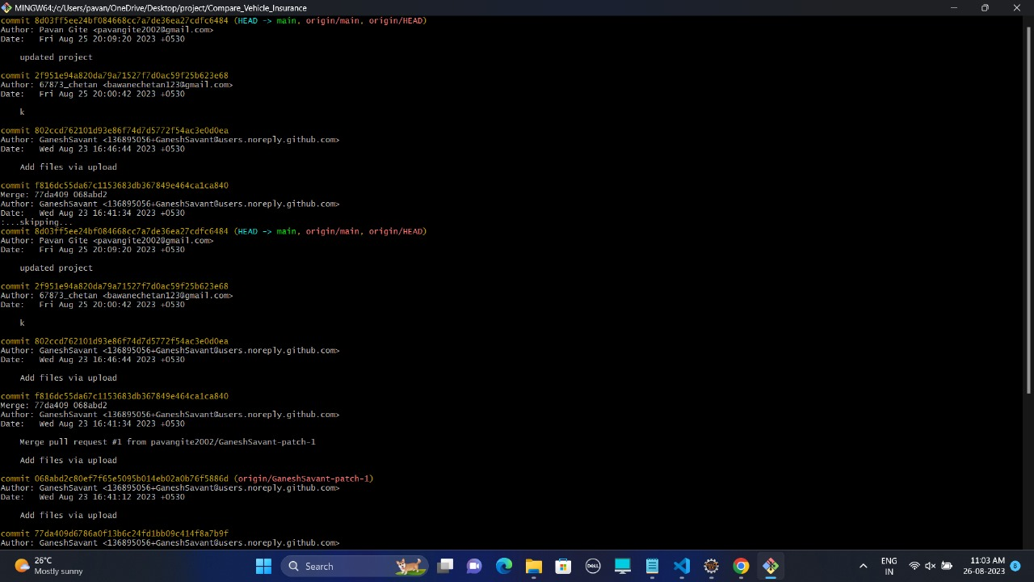
Git Status

Slide 13
Thank You

